Slide 1
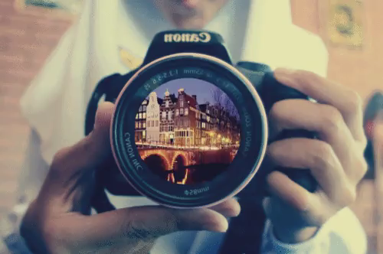
Lenses

Slide 2
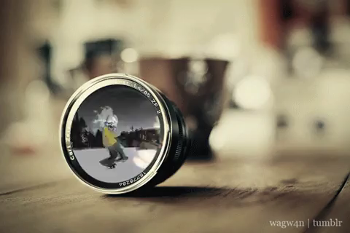
By the end of this Smart Lesson, you should be able to:
Describe the structure of convex and concave lenses.
Explain how light rays are bent as they pass through convex and concave lenses.
Contrast the different types of lenses.

Slide 3
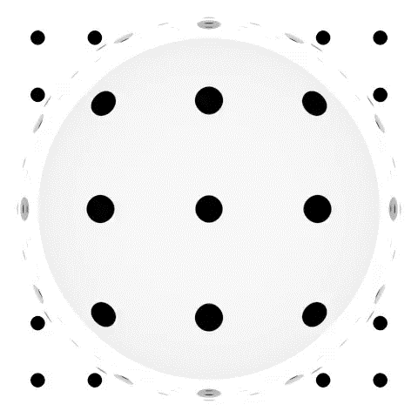
A lens is a curved, transparent piece of material that is used to focus light to produce an image.
This works because the rays refract as they move into and out of the lens.
Lenses make light change direction - this shrinks or magnifies an image.

Slide 4


Slide 5

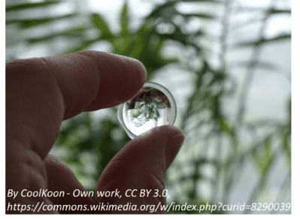
There are two types of lens - convex and concave.
A convex lens bulges out in the middle.
This is the type of lens that is found in glasses and cameras.

Slide 6
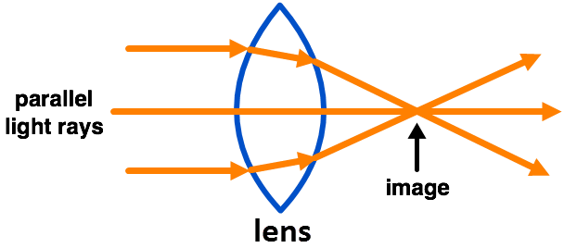
A convex lens causes parallel light rays to converge.
This means that the rays meet and form an image.
Remember: Convex lenses make light converge.

Slide 7
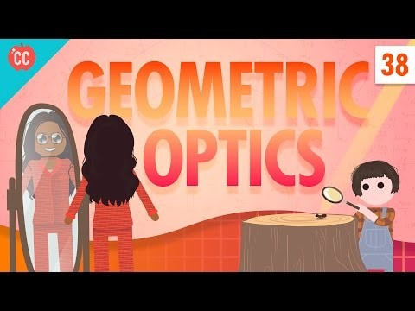

Slide 8
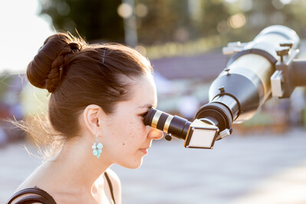
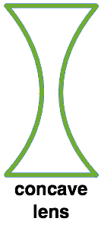
A concave lens curves in in the middle.
Concave lenses are used in flash lights, telescopes, binoculars and some types of glasses.

Slide 9
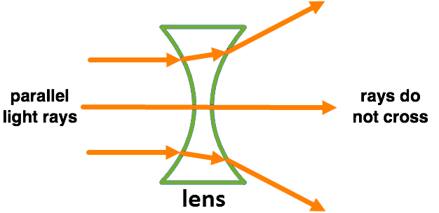
Concave lenses cause parallel light rays to diverge.
This means that they move apart and do not actually cross. However, you can still see an image with concave lenses.

Slide 10
